Slide 1


EDA ON IMDB 1000 Movies Dataset

Slide 2
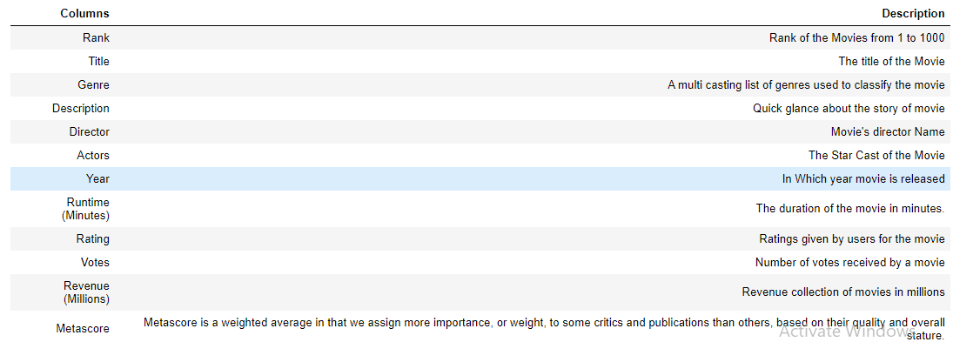
IMDB Dataset details for 1000 Movies
The Columns contains various fields like Rank, Title, Rating etc.

Slide 3
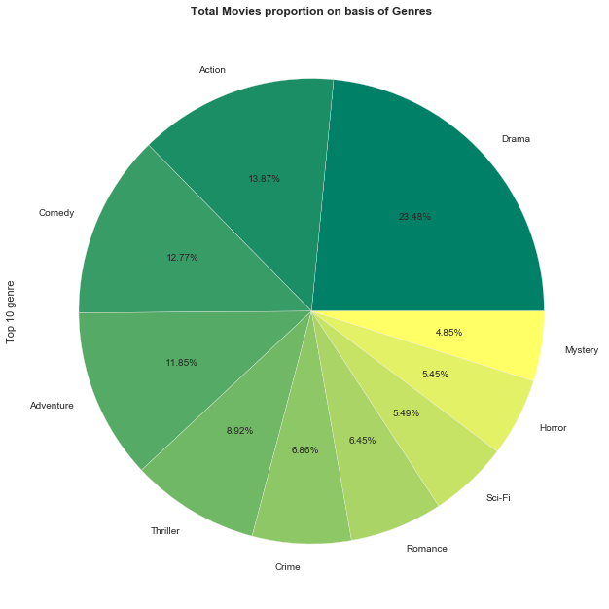
Top 10 movies count Basis on Genre
From the above graph we can see in Genre Drama movies has highest proportion followed by Action type &Comedy Type.

Slide 4
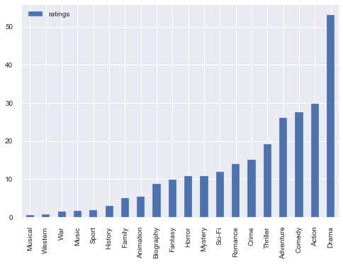
Which Genre Got Highest Rating
From the above we can see Drama movies got highest rating followed by Action & comedy

Slide 5
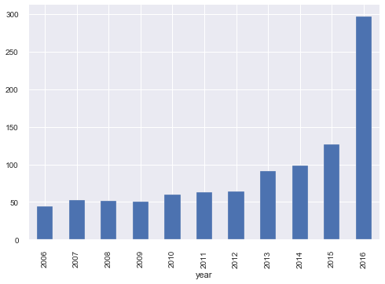
Which year Highest movies Released
From the above graph we can see in 2016 highest movies released followed by in 2015 & 2014

Slide 6
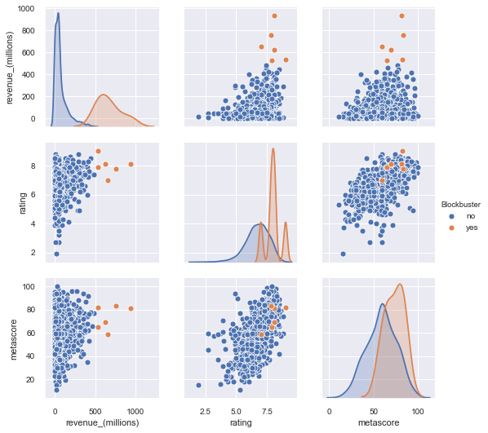
Checking Correlation using Revenue, Rating & Metascore
From the above graph we can see Rating & Metascore effects the Revenue of a movie

Slide 7
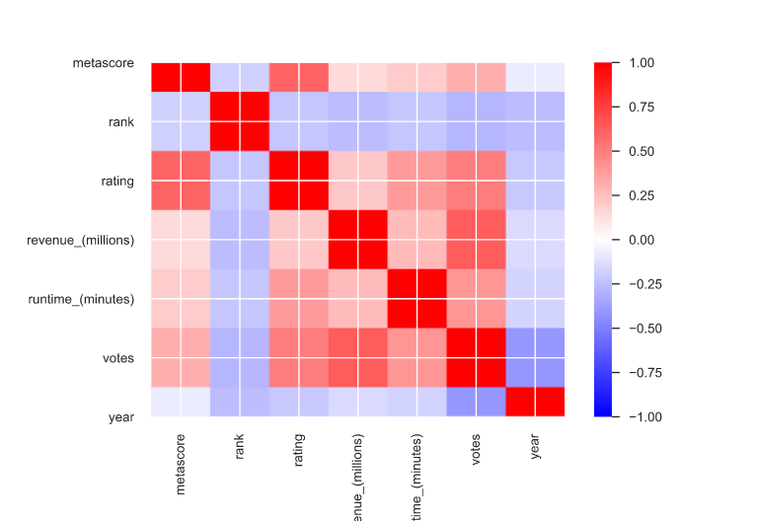
Correlation Feature
Correlation among various parameter

Slide 8
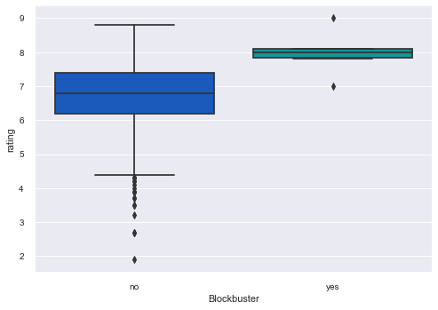
How Rating effects the Blockbuster of movie
From the above graph we can see Rating is not the solely parameter for Blockbuster of a movie.

Slide 9
Special Thanks to Suchit Sir

